Slide 1
Report on Indian- Elections- Analysis
Examination of Indian Election Data: State Election Records from 1977 – 2015
By
Gopalakrishnan Kumar, IIT-B Alumnus,
Freelance Data Science Consultant.
LinkedIn URL – https://www.linkedin.com/in/gopalakrishnan-kumar-a73301110/
Git Repository https://github.com/Gopalakrishnan-Kumar/Python-for-Data-Science
Website/blog URL https://www.kaggle.com/gopalkk1

Slide 2
Analysis of Indian Election Dataset: State Election Data from 1977 – 2015
1. Introduction The Indian Election Dataset offers a detailed look at state level election data spanning nearly four decades, from 1977 to 2015. This report aims to delve into the dataset's intricacies, uncovering significant trends, patterns, and insights.

Slide 3
Analysis of Indian Election Dataset: State and National Level Election Data from 1977 – 2015
2. Dataset Overview The dataset encompasses a wide range of election-related information, including:
1. Election year specifics
2. State and constituency details
3. Candidate particulars (name, party affiliation, votes obtained)
4. Election categorization (general, by-election, etc.)
5. Voter turnout figures
6. Election outcomes (successful candidate, victory margins, etc.)
The programming calculations are done by using Google Colab
https://colab.research.google.com/drive/129CE-2HOPDKJISTHiTcrvuASvJ-sPHN_

Slide 4


Sum of totvotpoll by st_name
Power BI Desktop
Sum of totvotpoll and Sum of electors by pc_name
Sum of totvotpoll Sum of electors
Sum of electors, Sum of totvotpoll and Sum of year by partyabbre
Sum of elec… Sum of t… Sum of y…
50bn
_{D} average elector
 
Sum of totvotpoll
0.5bn

Sum of totvotpoll a…
0.5bn
Sum of electors,…
1.12M
Average of electors
0.0bn
Uttar Pra…
West Ben… Andhra P…
Bihar Maharas… Tamil Na… Madhya … Karnataka Rajasthan
0.0bn
Aura…
Maha… Hami… Dum … Barasat Jadav… Aram… Tamluk Cooc… Murs… Hoog…
0bn
IND
INC BJP BSP SP JD
NOTA CPM
st_name
pc_name
partyabbre
Sum of totvotpoll by partyname and pc_type
pc_type GEN SC ST 1.0bn
Sum of totvotpoll by cand_name and st_name
st_name Andaman & Ni… Andhra Pra…
Sum of totvotpoll and Sum of pc_no by pc_type
Sum of totvotpoll Sum of pc_no
3bn
Sum of totvotpoll and Sum of year by st_name
Sum of totvotpoll Sum of year
Sum of totvotpoll
Sum of totvotpoll and Su…
Sum of totvotpol…
0.5bn
Sum of totvotpoll
5M
0.5bn
2bn
0.0bn
0M
1bn
0.0bn
Indian…
Bharat…
BJP INC
Com… Janata… Indep… Indian… Bahuj…
None O…
Anil Basu Mullap… Ram Vil… Mamat… Rupcha… Sharad … Hannan… Indrajit … Pawar S… Mulaya…
Uttar Pr…
West B… Andhra…
Bihar Mahara… Tamil N… Madhy… Karnata…
0bn
GEN
SC
pc_type
ST
partyname
cand_name
st_name

Slide 5
Inferences from Indian Elections Dataset
The maximum voter turnout is for Uttar Pradesh. West Bengal follows next
The average number of electors is 1.12 M
The total voter poll and electors is plotted against parliamentary constituency name
Several Analysis is done similarly

Slide 6
Analysis of Indian Election Dataset: State Level Election Data from 1977 – 2015
3. Data Analysis
3.1 Election Trends Over Time
→ Election Frequency: The dataset reveals a consistent increase in the number of elections held over the years, indicating the evolving nature of India's democratic process. A pie chart is used to simply calculate number of times each year occur, this is frequency and plot it over years.
→Voter Turnout: Analyzing voter turnout trends reveals fluctuations influenced by factors such as political climate, social movements, and voter awareness campaigns. Voter turnout is the percentage of voters registered who casted their votes.

Slide 7
Election Trends Over Time
Power BI Desktop
Count of year by year
Quick measure
year
1979
1992
1997
2015
1984
1982
2010
1983
1987
2001
1978
1999
2000
1994
2003
2006
1998
2011
2004
2005
2002
2007
2013
24.62K (7.52%)
0.39K (0.12%)
5.13K (1.57%)
5.73K (1.75%)
5.77K (1.76%)
5.9K (1.8%)
5.95K (1.82%)
6.17K (1.88%)
6.48K (1.98%)
6.68K (2.04%)
21.12K (6.45%)
17.74K (5.42%)
17.27K (5.28%)
7.35K (2.25%)
7.7K (2.35%)
17.06K (5.21%)
8.17K (2.49%)
10.04K (3.07%)
16.94K (5.18%)
10.98K (3.35%)
16.72K (5.11%)
11.32K (3.46%)
15.63K (4.77%)
14.12K (4.31%)
11.54K (3.53%)
11.97K (3.66%)

Slide 8
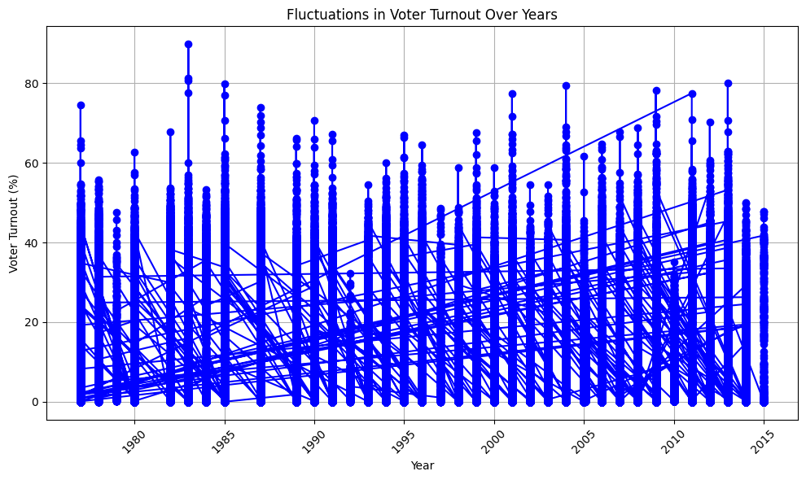
Election Trends Over Time

Slide 9
Analysis of Indian Election Dataset: State and National Level Election Data from 1977 – 2015
3.2 Party Performance
→Key Party Players: Identification of dominant parties in different states and regions based on their electoral performance over the years.

Slide 10
Sum of totvotpoll by partyname
0.6bn
Power BI Desktop
0.5bn
0.4bn
Sum of totvotpoll
0.3bn
0.2bn
0.1bn
0.0bn
Indian National Congress
Bharatiya Janata Party
INC BJP
Independent Communist Party Of India (M…
Independents Bhartiya Janta Party Bahujan Samaj Party
Janata Dal Indian National Congress (I)
Janata Party Telugu Desam
All India Anna Dravida Munn… Dravida Munnetra Kazhagam
Samajwadi Party
IND
Communist Party Of India
BSP
Bhartiya Janata Party Rashtriya Janata Dal
TDP
Shivsena
SP CPM
Janta Party Janata Dal (United)
All India Trinamool Congress Nationalist Congress Party
AITC NCP
Shiromani Akali Dal
SHS
Bharatiya Janta Party
BJD
partyname

Slide 11
Analysis of Indian Election Dataset: State Level Election Data from 1977 – 2015
4. Insights and Findings
→The party 'Indian National Congress' won the most votes with a total of 580596512.0 votes.
The party 'Indian National Congress' won the most percentage votes with a percentage of 0.19075589568995585 votes.

Slide 12
5. Conclusion Analyzing the Indian Election Dataset yields valuable insights into India's electoral landscape, offering a foundation for strategic decision-making, further research, and policy development. Understanding historical election trends aids in shaping future electoral strategies and governance frameworks.

Slide 13
6. Recommendations
→Dive deeper into specific election cycles or regions for nuanced insights.
→Investigate correlations between economic indicators, social factors, and electoral outcomes for a comprehensive understanding.
→Consider implications for political forecasting, voter education, and electoral integrity measures based on dataset findings.

Slide 14
References The citations for data analysis methodologies and any referenced literature or sources used in the report are as follows::
Acknowledgements
Bhavnani, Rikhil R., 2017, "India National and State Election Dataset", http://dx.doi.org/10.7910/DVN/26526 Harvard Dataverse Network V2.

Slide 15
Conclusion
Results are displayed in PowerBI Dashboards, Google Colab.

